Slide 1
Computer Networks
ICMP, IGMP, IPv6, Transition from IPv4 to IPv6

Slide 2
Topic
ICMP
IGMP
IPv6
Transition from IPv4 to IPv6

Slide 3
Network Layer Protocols
Network Layer Protocols
ARP
IPv4
ICMPv4
IPv6
ICMPv6

Slide 4
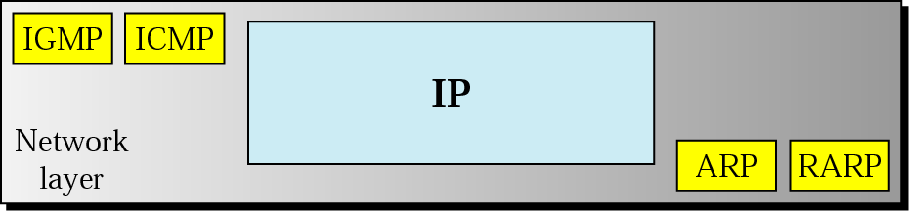
Network Layer Protocols
ARP Address Resolution Protocol
RARP Reverse Address Resolution Protocol
IPv4 Internet Protocol Version 4
ICMPv4 Internet Control Message Protocol Version 4
IPv6 Internet Protocol Version 6
ICMPv6 Internet Control Message Protocol Version 6
IGMP Internet Group Management Protocol
Figure 1 Network Layer Protocols

Slide 5
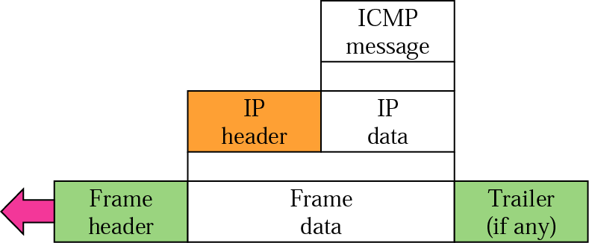
ICMP encapsulation
ICMP encapsulation
Figure 2 ICMP Encapsulation

Slide 6
ICMP need
Need of ICMP
ICMP always reports error messages to the original source.

Slide 7
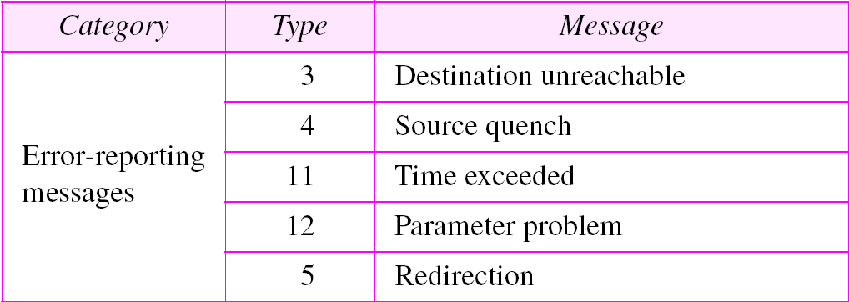
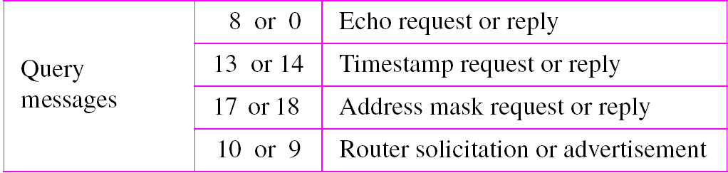
ICMP encapsulation
Table 1 ICMP messages

Slide 8
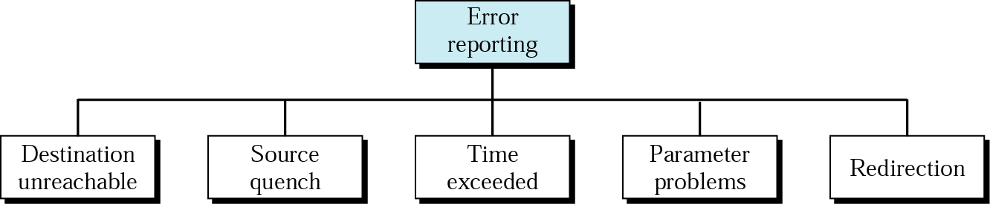
Types of Error Reporting Messages
Figure 3 Types of Error Reporting Messages

Slide 9
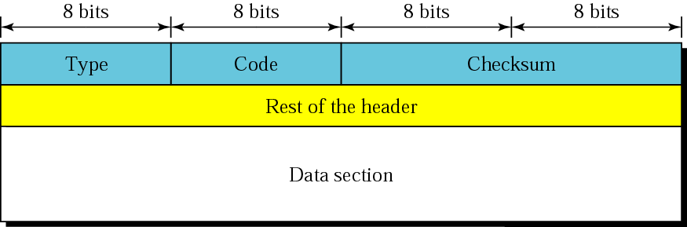
Types of Error Reporting Messages
Figure 4 General Format of ICMP Messages

Slide 10
Types of IP protocol communication
The IP protocol can be involved in two types of communication: unicasting and multicasting.
Unicasting is the communication between one sender and one receiver.
It is a one-to-one communication.
However, some processes sometimes need to send the same message to a large number of receivers simultaneously. This is called multicasting,
which is a one-to-many communication.
Multicasting has many applications. For example, multiple stockbrokers can simultaneously be informed of changes in a stock price, or travel agents can be informed of a plane cancellation. Some other applications include distance learning and video-on-demand.

Slide 11
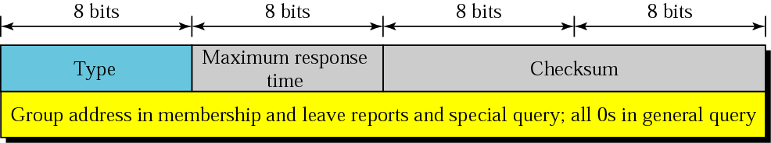
IGMP
The Internet Group Management Protocol (IGMP) is one of the necessary, but not sufficient, protocols that is involved in multicasting.
IGMP is a companion to the IP protocol.
IGMP is a group management protocol. It helps a multicast router create and update a list of loyal members related to each router interface.
Figure 5 IGMP Message Format

Slide 12
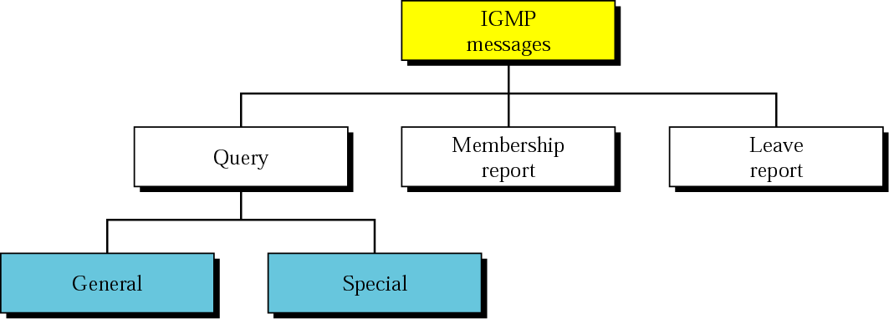
IGMP
IGMP has three types of messages: the query, the membership report, and the leave report. There are two types of query messages, general and special.
Figure 6 IGMP Message Types

Slide 13
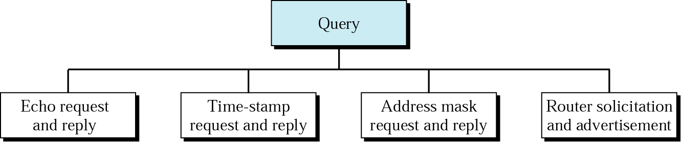
Query Messages
Figure 7 IGMP Query Message

Slide 14
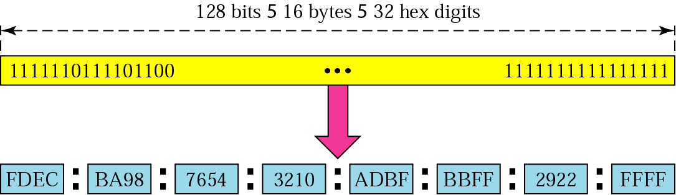
IPv6 address
Figure 8 IPv6 Address Format

Slide 15
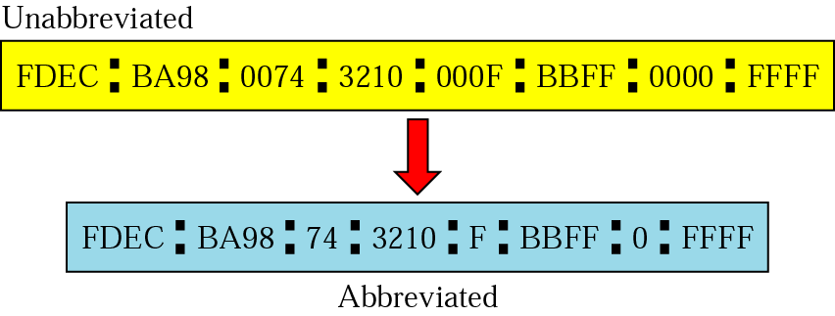
Abbreviated Address
Figure 9 IPv6 Abbreviated Address

Slide 16
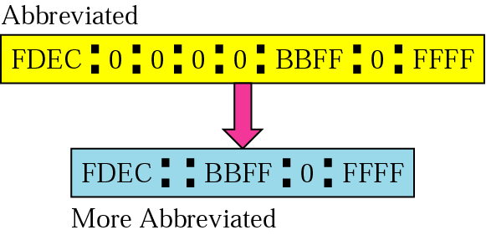
Abbreviated address with consecutive zeros
Figure 10 IPv6 Abbreviated Address with Consecutive Zeros

Slide 17
CIDR address
Figure 11 IPv6 CIDR Address Format

Slide 18
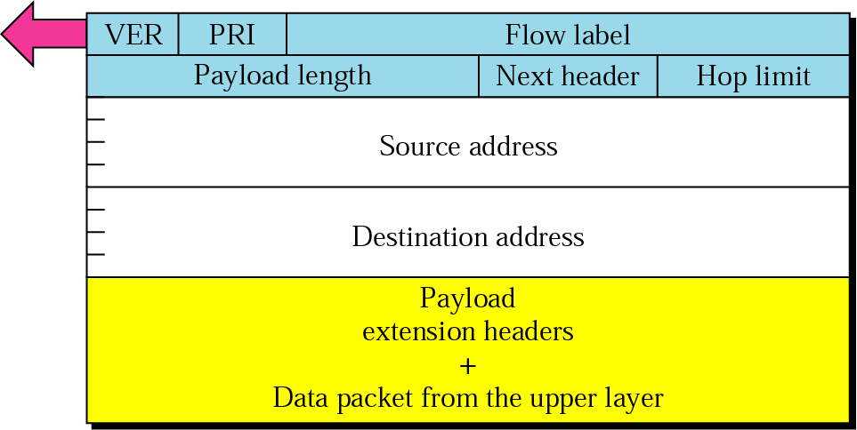
Format of an IPv6 datagram
Figure 12 IPv6 Datagram Format
Notes:
Version, Priority,

Slide 19
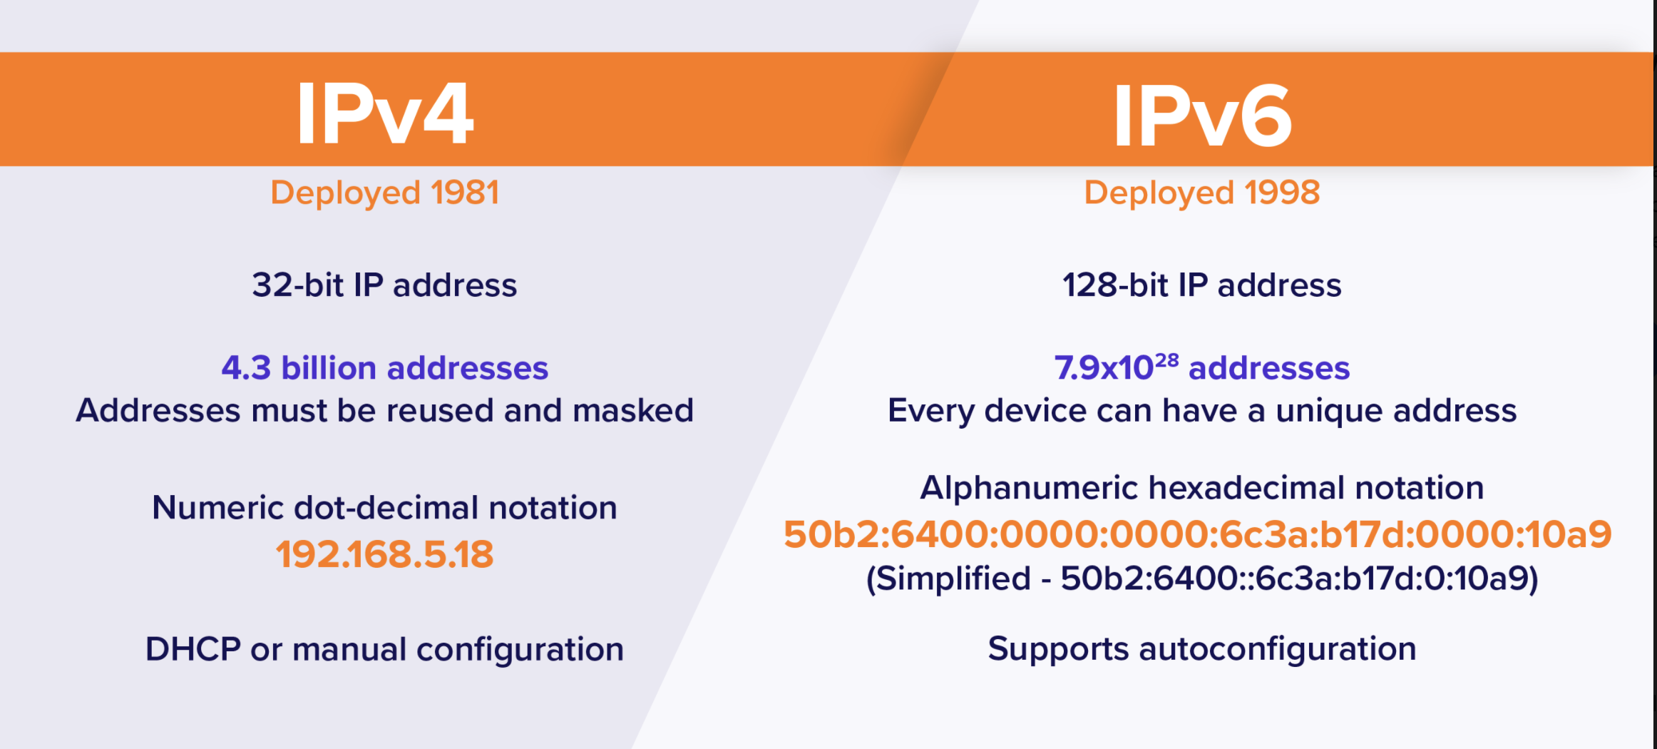
IPv4 Vs IPv6

Slide 20
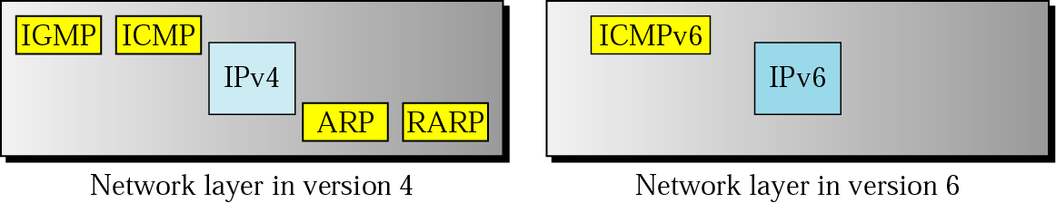
Comparison of network layers in version 4 and version 6
Figure 13 Comparison of Network Layers in IPv4 and IPv6

Slide 21
Practice Questions
Question 1
ICMP always reports error messages to ------- during error reporting.
Source
Destination
Station
None of these
Question 2
The Internet Control Message Protocol (ICMP) is the companion of -----.
IP Transmission
IP Packet
IP Frame
IP protocol

Slide 22
Practice Questions
Question 3
The Internet Control Message Protocol (ICMP) has the header size of ----- .
12 bytes
10 bytes
8 bytes
32 bytes
Question 4
The Internet Control Message Protocol (ICMP) messages are divided into two broad categories namely ---------.
Query and error reporting messages
Request and response messages
Request and reply messages
None of the above

Slide 23
Practice Questions
Question 5
IGMP stands for -------- .
Internet Group Management Package
Internet Group Management Path
Internet Group Management Protocol
Internet Group Management Ping
Question 6
The Internet Protocol (IP) packet that carries an Internet Group Management Protocol (IGMP) packet has a value of ------- .
0
1
2
-1

Slide 24
Practice Questions
Question 7
Internet Protocol Version (IPv6) has a larger address space of -------- .
2¹⁶
2³²
2⁶⁴
2¹²⁸
Question 8
The Internet Protocol Version 4 (IPv4) address is displayed as ------- .
4 bits
8 bits
16 bits
32 bits

Slide 25
Thank You

